Slide 1


Coaching and Managing Accountability Remotely
Presented by: Rick Lepsinger, President
Notes:
Welcome/introductions
Session will cover some of the key topics related to trust in a virtual setting. This work comes out of more than 10 years of research and consulting on virtual teams, which is further outlined in our recent book, Virtual Team Success.
We have tried to make it fairly interactive. We will not cover every single page in workbook but it is a very useful reference.

Slide 2

WELCOME TO
Coaching and Managing Accountability Remotely
Rick Lepsinger, President
rlepsinger@OnPointConsultingLLC.com | 212.472.8081

Slide 3
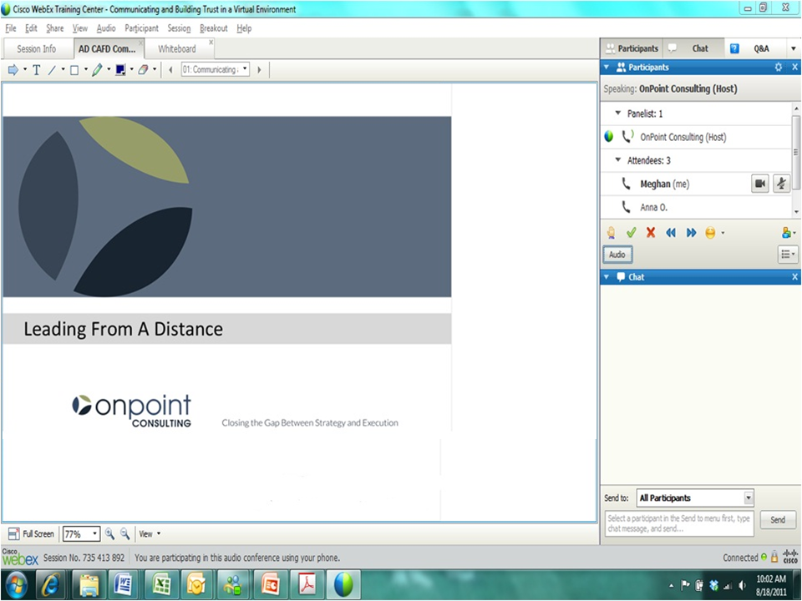
Notes:
Tell people about the WebEx tools we’ll use for communication (use the “pen” to circle the icons as you describe each one)
Audio button
Mute button
Hand icon
Green check
Red X
Chat box
Check to see that people have the workbook (ask them to click on the “green check” if they do)
For those who do not, remind them of the date the email with the workbook was sent and who sent it.
If they can’t find the email, ask one of the participants to email it to them
Transition: Before we review the objectives and agenda of today’s session let’s do brief introductions

Slide 4


Chat Box
Type your location and the weather into the “chat” box
4

Slide 5

Objectives
Understand how coaching and managing accountability is different in a virtual setting
Learn skills and techniques to effectively coach from a distance
Use two tools to help manage accountability from a distance
5
Notes:
Review session objectives

Slide 6

Virtual Team Study
A total of 48 virtual teams participated in the study:
427 team members and team leaders completed the team survey
99 stakeholders completed the team performance assessment
16 organizations from a variety of industries:
Pharmaceuticals
Financial Services
Consumer Products
Hospitality & Leisure
Manufacturing
Insurance
Professional Services
Telecommunications
Technology
Non-Profit
6
Notes:
Here is a snapshot of the study participants. Companies like Barclays, Kraft, Deloitte, Merck, AHA and Verizon Wireless participated and we have representation across a range of industries.

Slide 7


RAMP Model
Relationships
Accountability
Motivation
Purpose and Process
7
Notes:
When we took a close look at what factors differentiate top VTs, we came up with the RAMP model, which is a tool that outlines the four key dimensions for virtual success. As a VT leader, you would benefit from evaluating the extent to which these factors are in place in your team.
Relationships –this encompasses building trust in a virtual environment, managing conflict and enhancing collaboration.
Accountability is about establishing clear goals and making sure that individual and team commitments are still met
Motivation – how do you motivate people you may not see? This dimension is about engaging and recognizing people and the team as a whole
Purpose and Process is about creating a sense of shared purpose and establishing clear processes to support virtual work.
TRANSITION: Now that we have introduced the RAMP model, we will take a closer look at each dimension and provide tips that are essential for remote leadership. We will also give you a few opportunities to test your knowledge in situations that are common for VT leaders. We are going to start with the topic of enhancing trust in a virtual setting.

Slide 8
RAMP Model
Relationships
Accountability
Motivation
Purpose and Process
Coaching From a Distance
8
Notes:
While we will not spend a lot of time on remote coaching, it is a hot topic and one that people are often interested in since some leaders struggle with it. Let’s spend a few minutes talking about why coaching is different in a virtual setting.

Slide 9
Chat Discussion
What is your greatest challenge when coaching from a distance?
9
Notes:
Let’s take a few minutes to discuss some of the specific challenges that you face when leading from a distance.
After discussion, reinforce key points and make transition to research, which tried to address some of the very challenges that you mentioned.

Slide 10

Virtual Coaching Is Different
Need to address issues relevant for virtual workers such as isolation or work/life balance due to time zone challenges
Due to the lack of visual cues, active listening skills become even more essential
Fewer opportunities to “observe” performance
10
Notes:
There is a need to address some challenges specific to virtual work: feeling of alienation, being out of the loop, balancing work-life commitments (out of hour meetings), misunderstanding. Employees might need coaching and support in dealing with these issues.
Less opportunities to directly observe performance: may be necessary to review team communication to understand the level of performance, or collect 360 assessment
Feedback becomes even more important, since overall there are fewer other opportunities for employee to understand how he/she is doing
Different perceptions regarding email: research shows that when sender thinks email is positive , the receiver perceives it as neutral; when sender thinks email is neutral, receiver perceives it as negative.
Before we share some coaching tips, let’s practice applying coaching skills to a few challenging situations.

Slide 11
Virtual Coaching Is Different
Even more feedback is needed, yet fewer opportunities to deliver it in a timely manner
Coaching people who don’t report directly to you tends to be more common
Some communication channels might distort the tone or understanding of your message
11
Notes:
There is a need to address some challenges specific to virtual work: feeling of alienation, being out of the loop, balancing work-life commitments (out of hour meetings), misunderstanding. Employees might need coaching and support in dealing with these issues.
Less opportunities to directly observe performance: may be necessary to review team communication to understand the level of performance, or collect 360 assessment
Feedback becomes even more important, since overall there are fewer other opportunities for employee to understand how he/she is doing
Different perceptions regarding email: research shows that when sender thinks email is positive , the receiver perceives it as neutral; when sender thinks email is neutral, receiver perceives it as negative.
Before we share some coaching tips, let’s practice applying coaching skills to a few challenging situations.

Slide 12
Four Principles of Virtual Coaching
Balance a focus on task and relationships
Don’t make assumptions – provide context and more detail; ask specific questions to make up for the lack of visual cues
Notes:
Ask lots of obvious questions – ask questions that might be obvious if you were face-to-face

Slide 13
Four Principles of Virtual Coaching
Encourage the other person to respond; ask the person to restate what they heard
Increase the use of active listening to confirm understanding to build trust
Notes:
Ask lots of obvious questions – ask questions that might be obvious if you were face-to-face

Slide 14

Skills for Remote Coaching
Active listening
Focus on behavior
Balanced response

Slide 15
Active Listening Skills
Paraphrasing
Empathizing
Questioning

Slide 16
Paraphrasing
How to - Summarize the content of what the other person has said, in your own words
Purpose - Shows that you understand (but not necessarily agree with) what the other person said
If you disagree, restate the other person’s point of view before stating your own
Notes:
Paraphrasing is restating what you heard the other person say in your own words. It is used to show that you understood, but not necessarily that you agree with, what the other person said. If you disagree, or in a conflict situation, restate the other person’s point of view before stating your own.

Slide 17
Example
Statement
“I’m not sure about how to handle the situation with the client and because I’m new to the account I think it would be better if you spoke with her.”
Paraphrase
“You’re concerned that because you’re not familiar with the history of this account you won’t handle it properly?”

Slide 18
Empathizing
Summarize your understanding of how the person is feeling and why – the emotional component of the message
Be patient and non-judgmental
Do not interrupt. Let people vent if they are upset
Overcome the urge to ignore, disagree with, or reject what people say
Notes:
Mention that misunderstandings can occur when people are face to face
Because of the lack of visual cues the likelihood of misunderstandings greatly increases when people are working virtually.
The increased (proactive, frequent, and consistent) use of paraphrasing is an example of the change in behavior and habit effective virtual leaders make.
When?
You want to check your understanding of what the person said
The person has said something confusing or complex
A team member is rambling or stuck on a point
Why?
Shows that you understand (but not necessarily that you agree with) what the other person is saying
Moves the conversation along without eroding self-esteem
How?
Summarize the content of what the other person has said, in your own words. Do not show approval or disapproval, and avoid “parroting” the person (using his/her exact words)
Work hard to understand the other person’s point of view (rather than planning your rebuttal)
If you disagree, restate the other person’s point of view before stating your own

Slide 19
Example
Statement
“Solve one problem and up pops another. What’s the use?”
Empathetic Response
“It can be pretty frustrating, and even discouraging, to encounter problem after problem.”

Slide 20
Questioning
What
Probing to find out more about what the person said or about why he/she said it
When
You need a better understanding of a situation
You need to guide the conversation
You want to gather specific information
You want to involve the other person

Slide 21
Questioning
How
Use open-ended questions
Ask questions that encourage “how can we?” thinking
Avoid asking questions that put people on the defensive (for example, “Why did you…?” “Why didn’t you…?”)
Avoid leading questions (for example, “Don’t you agree that…?”)
Don’t ask, “Do you understand?” to check for understanding!

Slide 22
Chat Box
Read each question and decide if it is effective or ineffective.
“What are your concerns about the project?”
“Why didn’t you tell me about the issue sooner?”
“What do you see as the obstacles? How can we overcome them?”
“Don’t you think it’s best to change the price now?”

Slide 23

Focus on Behavior
Focus on Behavior
Focus on behavior rather than on attitude and personality

Slide 24
Labels Versus Behavior
Labels | Behaviors
General Evaluative Opinions/Conclusions Gut Feelings | Specific Descriptive Actions (what said/did) Observable

Slide 25
For Example
Rather than saying...
“Your lack of commitment caused the whole project to fail.”
It’s more effective to say:
“Jack, you agreed to complete the report by Friday. When you didn’t meet the deadline, the team was unable to complete the analysis and meet the client’s deadline. The team lost credibility and our client didn’t meet its project target date.”

Slide 26
Polling Question
Which is the best example of a behavior?
Positive attitude
Disrespectful
Good team player
Interrupts people
Lack of commitment

Slide 27
Identify Behavior
What did the person do or say that indicated that she ______ (e.g., has a bad attitude, is uncooperative, or is doing the full job)
Keep asking the question until it does not make sense to ask the question again

Slide 28

Identify Behavior
If your answer to the question, “What did she do to indicate she was procrastinating?” is “She did not hand the report in on time,” you know asking the question again will not yield anything more specific.

Slide 29

Balanced Response
A technique for providing constructive feedback about an idea or proposal a virtual team member or colleagues has suggested without being confrontational or diminishing self-esteem
Notes:
A balanced response is a technique for providing constructive feedback about and idea or proposal a matrix partner has suggested without being confrontational or diminishing self-esteem. A balanced response has several benefits. It allows strengths to be leveraged regardless of weaknesses, it allows weaknesses to be overcome without losing sight of strengths, it highlights points of agreement, it ensures consideration of new and unusual ideas, and it effectively positions concerns for problem solving. Let’s take a look at how to effectively apply this communication technique.

Slide 30
Balanced Response
Benefits:
Allows strengths to be leveraged regardless of weaknesses
Allows weaknesses to be overcome without losing sight of strengths
Highlights points of agreement
Ensures consideration of new and unusual ideas
Positions concerns for problem solving
Notes:
A balanced response is a technique for providing constructive feedback about and idea or proposal a matrix partner has suggested without being confrontational or diminishing self-esteem. A balanced response has several benefits. It allows strengths to be leveraged regardless of weaknesses, it allows weaknesses to be overcome without losing sight of strengths, it highlights points of agreement, it ensures consideration of new and unusual ideas, and it effectively positions concerns for problem solving. Let’s take a look at how to effectively apply this communication technique.

Slide 31

Using a Balanced Response
First, state what you like about the person’s idea or suggestion—focus on the positives.
Second, state what you see as the key concerns or what keeps the person’s idea or suggestion from being totally acceptable
Notes:
A balanced response is a technique for providing constructive feedback about and idea or proposal a matrix partner has suggested without being confrontational or diminishing self-esteem. A balanced response has several benefits. It allows strengths to be leveraged regardless of weaknesses, it allows weaknesses to be overcome without losing sight of strengths, it highlights points of agreement, it ensures consideration of new and unusual ideas, and it effectively positions concerns for problem solving. Let’s take a look at how to effectively apply this communication technique.

Slide 32
Using a Balanced Response
State these concerns in an actionable, “How to...” form
Use “and” when transitioning from your positive comments to your concerns rather than “but”
Notes:
A balanced response is a technique for providing constructive feedback about and idea or proposal a matrix partner has suggested without being confrontational or diminishing self-esteem. A balanced response has several benefits. It allows strengths to be leveraged regardless of weaknesses, it allows weaknesses to be overcome without losing sight of strengths, it highlights points of agreement, it ensures consideration of new and unusual ideas, and it effectively positions concerns for problem solving. Let’s take a look at how to effectively apply this communication technique.

Slide 33
Balanced Response: Example
Colleague:
“Rolling out this new reporting format now would be a big mistake. We need another two weeks of development before we can say it’s more efficient and informative.”
Manager:
“You’re right about the additional time. It would mean that we have a format that’s reliable. How can we do this without appearing unresponsive?”
Notes:
This exchange between and manager and her direct report is an example of a balanced response since the manager focused on the positive aspects of her downline’s idea. Also, she added to the thought by using a “how to” statement.

Slide 34

Remote Coaching Exercise
Review case studies
What are your objectives for this coaching conversation?
How you will adapt your approach for a virtual setting – before, during , and after the conversation
34

Slide 35
Remote Coaching Tips
Be aware that virtual workers face unique challenges (e.g., isolation, use of technology, time zone differences, work/life balance)
Establish formal processes to monitor individual and team performance
Periodically work flexible hours so you can be available when team members are working
35

Slide 36
Remote Coaching Tips
Find a mentor/partner at employee’s location who can be a resource
Make regular and impromptu contact with team members
Face-to-face is best, then video and then the phone – use email to summarize conversations
36

Slide 37
RAMP Model
Relationships
Accountability
Motivation
Purpose and Process
Managing Accountability Remotely
37
Notes:
Let’s take a deeper dive into the second topic, managing accountability remotely.

Slide 38
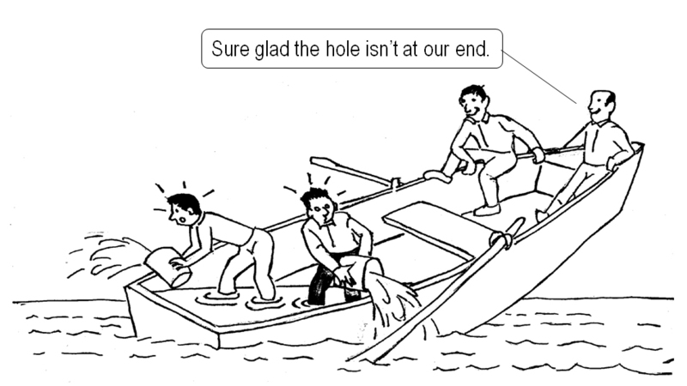
Managing Accountability Remotely
Notes:
Accountability is a topic that often comes up when we ask virtual leaders what they find challenging. This is especially true if you are leading matrixed or project teams where team members do not report to you.
Like this cartoon shows, it is much easier for people to hide from accountability in a virtual setting and we will discuss this further shortly.
Transition: Let’s take a minute to define accountability and look at the accountability scale, which is one useful way to consider this concept.

Slide 39


Accountability Defined
We take initiative
We accept responsibility for our actions
We accept responsibility for how our actions impact others
We admit when we make mistakes
No excuses. No blaming

Slide 40
Accountability in a Virtual Setting
Autonomy is essential – meeting deadlines and quality is more important than when people work
Different metrics might be necessary to measure performance
More challenging to monitor and discuss progress
Notes:
Managers need to trust employees and not micro-manage and check-in too often
At the same time remote employees might not be aware of the change in priorities, so leaders need to help people adjust priorities when situation changes
Team members become less aware of what others are doing. Therefore there might be less peer influence to accomplish certain tasks on time.
Managers need to balance the need to monitor the performance with the need to respect person’s autonomy. Virtual environment also makes it less convenient for people to discuss hesitations or challenges they face in working on the project. So the managers need to proactively probe if there are any obstacles and if the employee needs support in overcoming these.
With less face time, there are fewer opportunities to directly observe performance. This is why it might make sense to develop alternative performance measures. It can also be the case that metrics need to be comparable across team members with different areas of responsibility. For such instances we might want to consider an example of one of the virtual leaders from and IT consultancy:
“I’ve created an activity based scoring template: every activity has a certain score based on strategic involvement in organizational goals (weekly basis).” Scoring template provides quantitative measure of performance (goal is 600 points). On weekly team calls everybody talks about individual goal achievement.
Ask people to submit recap/summary of daily/weekly activity/accomplishments (e.g., merchandisers take photo of product set up, insurance engineers submit site inspection reports)

Slide 41
Accountability in a Virtual Setting
Team members’ contributions are less visible and “social loafing” may occur
Lack of physical proximity may make it difficult for people prioritize projects as things shift
Notes:
Managers need to trust employees and not micro-manage and check-in too often
At the same time remote employees might not be aware of the change in priorities, so leaders need to help people adjust priorities when situation changes
Team members become less aware of what others are doing. Therefore there might be less peer influence to accomplish certain tasks on time.
Managers need to balance the need to monitor the performance with the need to respect person’s autonomy. Virtual environment also makes it less convenient for people to discuss hesitations or challenges they face in working on the project. So the managers need to proactively probe if there are any obstacles and if the employee needs support in overcoming these.
With less face time, there are fewer opportunities to directly observe performance. This is why it might make sense to develop alternative performance measures. It can also be the case that metrics need to be comparable across team members with different areas of responsibility. For such instances we might want to consider an example of one of the virtual leaders from and IT consultancy:
“I’ve created an activity based scoring template: every activity has a certain score based on strategic involvement in organizational goals (weekly basis).” Scoring template provides quantitative measure of performance (goal is 600 points). On weekly team calls everybody talks about individual goal achievement.
Ask people to submit recap/summary of daily/weekly activity/accomplishments (e.g., merchandisers take photo of product set up, insurance engineers submit site inspection reports)

Slide 42

David Missing Deadlines
It has come to your attention that David has been consistently missing deadlines. He recently missed two important deadlines which caused a delay in a product release.
David’s performance is negatively impacting the team and you need to take action. However, because David does not report directly to you, managing this may be difficult. David’s Manager is Pamela Jones, your colleague.
Notes:
You “Wait and hope” that poor performance will improve on its own without a conversation about meeting commitments and delivering results.
You assume that sending indirect messages and subtle signals will convey your dissatisfaction and clarify what needs to happen differently.
You are certain that differing points of view will lead to an uncomfortable conversation or a real disagreement, and decide to let it go and avoid the conflict.
You have not clarified what “good looks like” or when you want projects done, meaning the baseline of clear expectations has not been set.
You are inclined to give top performers more leeway because you don’t want to break their momentum.
You equate following up and monitoring progress with micro-managing, and fear being labeled negatively.
You take on the work yourself and become complicit in the cycle of poor performance and lack of accountability.

Slide 43
How Would You Handle It?
Call Pamela Jones, David’s boss, to explain the issue with David’s performance and explore what she can do to help enhance his accountability.
Send David an email to ensure that he understands the impact of missed deadlines on the team and its customers.
Ask David what he will do to get the projects back on track, what he will do to keep from missing deadlines in the future, and what he might have done that contributed to the problem.
Clarify your expectations for David’s performance and for his current projects agree on periodic check points when you and he will discuss progress and anticipate potential problems.
Hold a team v-meeting to discuss the importance of meeting deadlines and identify solutions to existing barriers that are getting in the way.
Notes:
What do you do to address the situation with David?
Top leaders choose RESPONSE C, which uses a technique called the 3 Accountability questions to address the source of a problem, what a person will do to resolve the problem, and what they will do to prevent it in the future. In some highly matrixed organizations or where you have a new team leader who does not know the individual well, RESPONSE A could be very effective. In this case, you would call David’s boss to help problem solve the issue prior to reaching out to David.
Response B, sending an email, is not effective, especially because emails can be misinterpreted.
Response D, is a good response in that it gets at a resolution for the current problem. However, it does not address the source of the problem, which could mean that this happens again.
Response E, a team meeting, is not effective since it does not really address David’s individual performance issues. There is also a good chance that this action could lead to frustration by other team members, who know that David is the source of the problem and believe that he is not being held accountable.

Slide 44

Four Accountability Busters
Talking about an idea, but not agreeing to actions and accountability by people’s names,
Agreeing on an action, but without any discussion of a completion date
Notes:
Now that we have given you a few situations to practice dealing with accountability, let’s take a look at the 4 mistakes many leaders make and then we will also discuss 2 strategies for enhancing accountability.
We call these the four “accountability busters” - The bottom line is, you can’t hold people accountable if you haven’t been clear about expectations or due dates.
Let’s take a look at the first accountability tool.

Slide 45
Four Accountability Busters
Waiting until the completion date to check on the results, or not even checking in at all
Not holding people accountable for missed commitments after the fact
Notes:
Now that we have given you a few situations to practice dealing with accountability, let’s take a look at the 4 mistakes many leaders make and then we will also discuss 2 strategies for enhancing accountability.
We call these the four “accountability busters” - The bottom line is, you can’t hold people accountable if you haven’t been clear about expectations or due dates.
Let’s take a look at the first accountability tool.

Slide 46
Polling Question
Which of the four accountability mistakes do you observe being made most often?
Talking about an idea, but not agreeing to actions and accountability by people’s names
Agreeing on an action, but without any discussion of a completion date
Waiting until the completion date to check on the results, or not even checking in at all
Not holding people accountable for missed commitments after the fact

Slide 47

Accountability Booster
Set People Up For Success
Action
Timetable
Checkpoints
Notes:
The first tool is used to set people up for success and provide the foundation for holding others accountable. The acronym ATC (air traffic controller) can help you to remember this technique.
Review the technique:
Action – Regardless of how good an idea someone has or how sincere their intention, nothing happens until someone commits to taking some action. Actions must be stated in behavioral language. Who specifically will do what? You can’t hold someone accountable if you have not been clear about the expected deliverables.
Timetable – This defines who will do what by when? Commitments that don’t have a time frame usually fall by the wayside. You can’t hold someone accountable if you have not been clear about the due date.
Checkpoints – This defines checking in NOT when the action should be completed (checking in at this point is too late if there is a problem), but completing a progress check BEFORE the completion date. If you agree on check points with the person it allows you to monitor without the other person feeling like you are micromanaging or abdicating your responsibility. It also provides and opportunity for coaching, problem solving and “course corrections” well before the deadline

Slide 48
Virtual Guidelines for Using ATC
Action
Use action plans and team project management sites to clarify expectations and who is accountable
Create a system to store team documents and communications
Notes:
Action and Timetable example - “Make sure that the status of goals is posted in central place (everybody can see them, but won’t list sensitive stuff). Make it more visible what others are doing, ensure transparency.”
Timetable:
Pre-scheduled follow-ups along the way;
Send monthly progress toward goals report to everyone – increase transparency
During weekly calls talk as a team to reinstate objectives and accountabilities (peer pressure)

Slide 49
Virtual Guidelines for Using ATC
Timetable
Set specific deadlines; post action plan on shared site
Use automatic reminders to notify team members
Notes:
Action and Timetable example - “Make sure that the status of goals is posted in central place (everybody can see them, but won’t list sensitive stuff). Make it more visible what others are doing, ensure transparency.”
Timetable:
Pre-scheduled follow-ups along the way;
Send monthly progress toward goals report to everyone – increase transparency
During weekly calls talk as a team to reinstate objectives and accountabilities (peer pressure)

Slide 50
Virtual Guidelines for Using ATC
Checkpoints
Agree to check in at key milestones; integrates project management with coaching
Provides an opportunity to build trust and relationships
Notes:
Action and Timetable example - “Make sure that the status of goals is posted in central place (everybody can see them, but won’t list sensitive stuff). Make it more visible what others are doing, ensure transparency.”
Timetable:
Pre-scheduled follow-ups along the way;
Send monthly progress toward goals report to everyone – increase transparency
During weekly calls talk as a team to reinstate objectives and accountabilities (peer pressure)

Slide 51

Three Coaching Questions
After-the-Fact Accountability Booster
Past: “What could you have done to prevent the problem? What, if anything, did you do that might have possibly contributed to the problem”?
Present: “What can you do NOW to get on track?”
Future: “What can you do to prevent this problem from happening again in the future?”
Notes:
Review the second strategy for accountability:
If someone misses a target, you can coach the person you are trying to hold accountable by asking him/her to review these three questions.
Let’s spend a few minutes applying the accountability concepts to your own team/team members/direct reports.

Slide 52
Accountability Tips
Frequently reinforce and update team goals and individual responsibilities
Leverage technology to track progress on assignments (e.g., shared sites and project management sites)
Use meaningful metrics that connect individual contributions to team goals
39
Notes:
Leaders on less effective VTs struggled with accountability. During our interviews, we heard things like “the leader does not follow up to make sure we hit deadlines” or “no one really holds one another accountable for what we are responsible for as a team”.
One team set up a team handbook to outline accountabilities and key goals, and they periodically updated this over time.
Because people are often expected to work more independently in virtual teams, finding ways to delegate work, to give team members freedom to make decisions and to monitor work become particularly important for success. Top virtual team leaders establish mechanisms to monitor team member’s work without micromanaging.
While accountability seems straightforward, many leaders forget the basics when working virtually.

Slide 53
Accountability Tips
Ensure transparency in individual tasks and goals and project status
Periodically collect feedback from stakeholders to assess the team’s level of performance
Encourage a problem-solving attitude instead of making excuses or blaming others
39

Slide 54
Accountability Tips
Use checkpoints as “coachable moments” for “course correction” and as an opportunity to build trust
Reinforce positive behavior and address below standard performance in a timely manner
39

Slide 55
Self-Assessment
Complete the self-assessment
For any items you scored a 2 or lower reflect on what prevents this practice from being used consistently and what you could do to address these issues.
Identify items where you scored a 3 and consider how you might implement practices to improve in these areas.
39

Slide 56
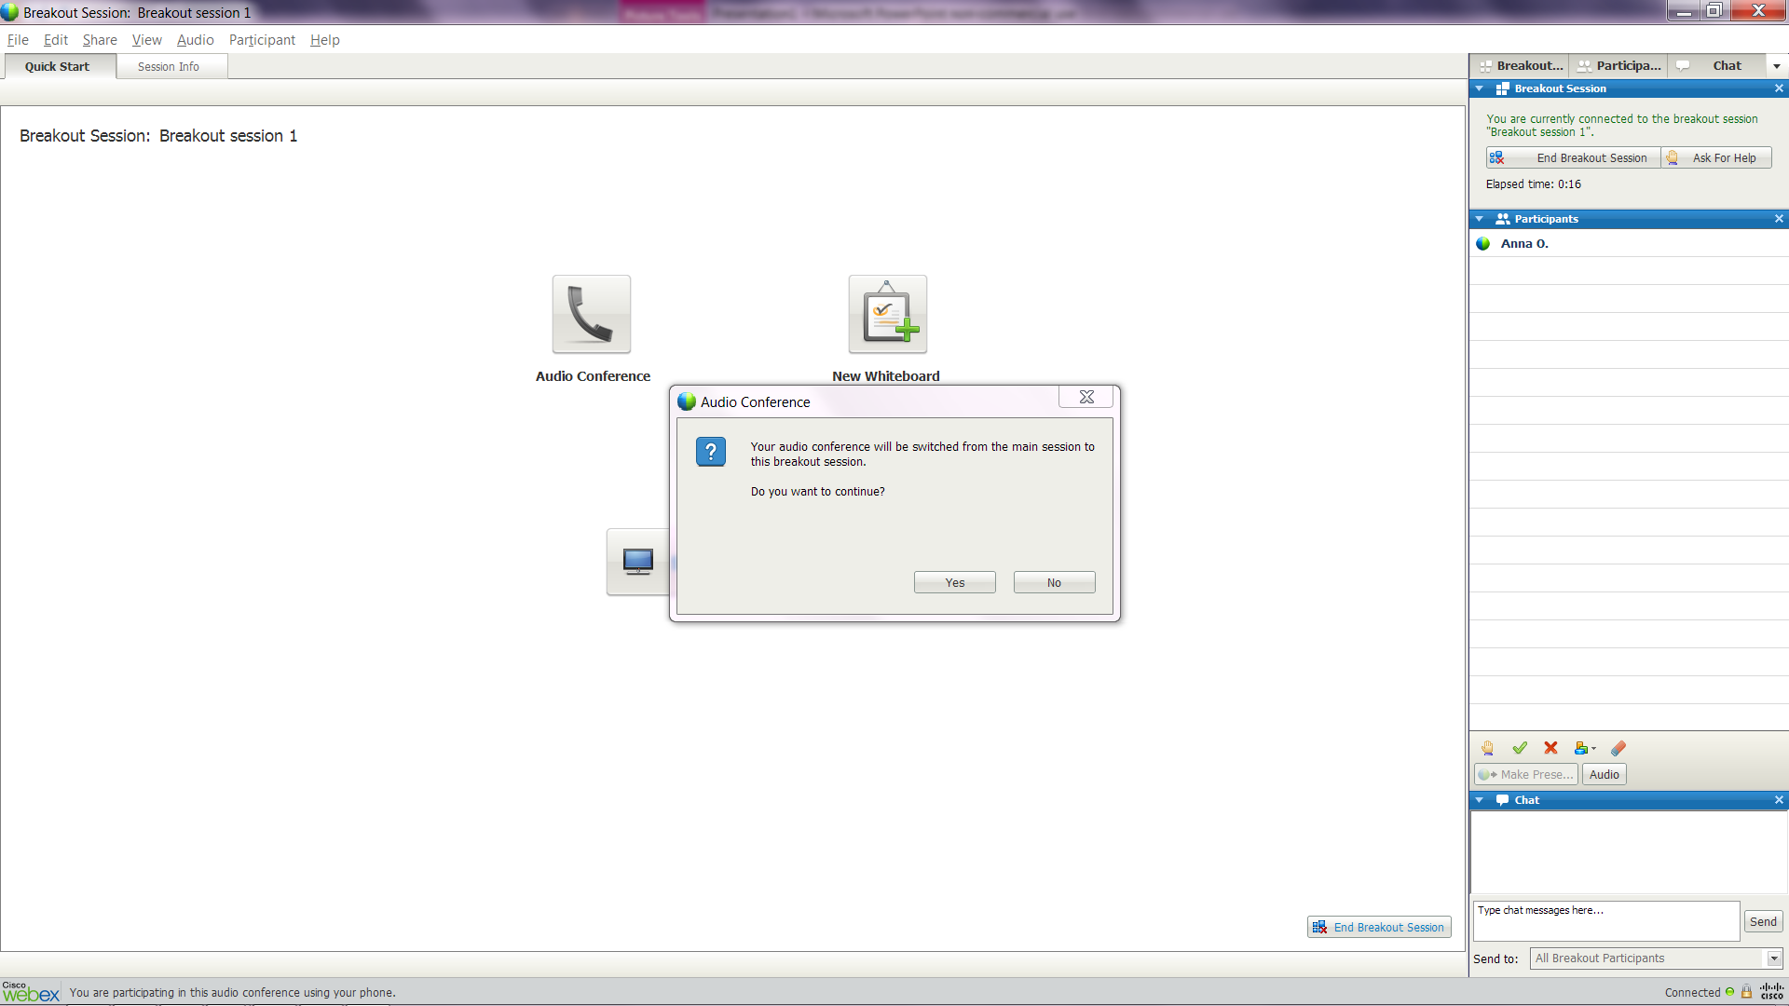
Notes:
Explain that you will form the groups randomly
The first person selected to each group is designated as the “presenter”
When I start the breakout groups the presenter will see this page
Click “yes” and the rest of the group will be invited to join. Everyone should also click “yes”
Point out the “help” button at the upper right hand corner. They can click this if they have a question and you’re not in their room at the time.
Assign 3 people to each break out
If you need to do a group of four one person will not get to take the team leader role
If you need to have a group of 2 they will only do two role plays and they will debrief without an observer.

Slide 57
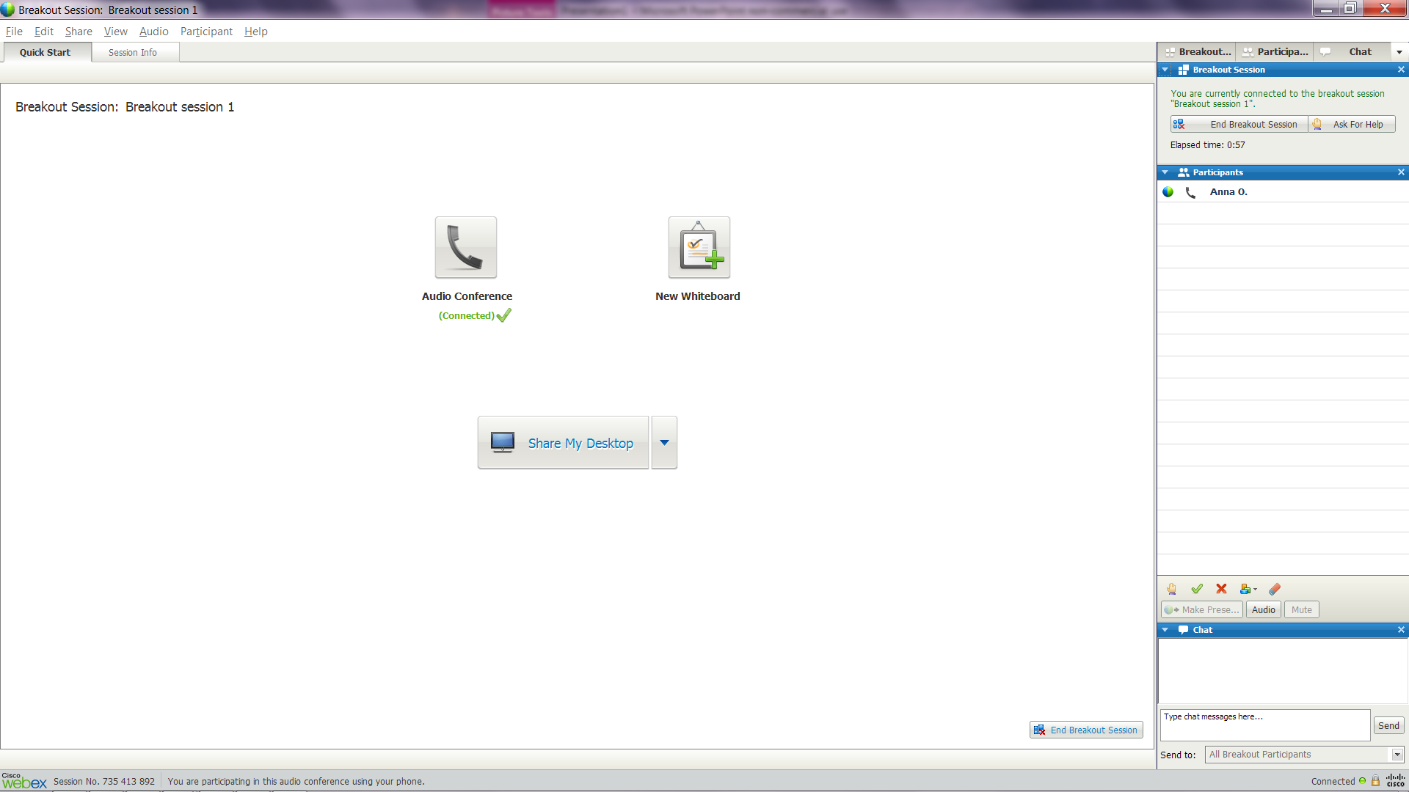
Notes:
Once your in your groups your screen will look like this
I will come around and “visit” each group to see if you have any questions and to listen in to your discussion.
Point out the “hand” icon on the right hand side at the top. They can click on this if they have a question and you’re not in their room at the time.

Slide 58

Self-Assessment
Meet in small groups to discuss:
What you are currently doing well to set people up for success and maintain momentum?
What you could do differently or better – where are the gaps?
What actions can you take to enhance the level of accountability among your team?
39

Slide 59
Chat Box
What are you going to do to enhance your ability to effectively coach and manage accountability remotely?
59

Slide 60

Best Practices
Remember that virtual workers face unique challenges such as isolation or work/life balance due to time zone challenges
Active listening skills become even more essential
Notes:
There is a need to address some challenges specific to virtual work: feeling of alienation, being out of the loop, balancing work-life commitments (out of hour meetings), misunderstanding. Employees might need coaching and support in dealing with these issues.
Less opportunities to directly observe performance: may be necessary to review team communication to understand the level of performance, or collect 360 assessment
Feedback becomes even more important, since overall there are fewer other opportunities for employee to understand how he/she is doing
Different perceptions regarding email: research shows that when sender thinks email is positive , the receiver perceives it as neutral; when sender thinks email is neutral, receiver perceives it as negative.
Before we share some coaching tips, let’s practice applying coaching skills to a few challenging situations.

Slide 61
Best Practices
Increase the use of video
Leverage technology to track progress on assignments (e.g., shared sites and project management sites)
Ensure transparency of individual tasks and goals and project status
Notes:
There is a need to address some challenges specific to virtual work: feeling of alienation, being out of the loop, balancing work-life commitments (out of hour meetings), misunderstanding. Employees might need coaching and support in dealing with these issues.
Less opportunities to directly observe performance: may be necessary to review team communication to understand the level of performance, or collect 360 assessment
Feedback becomes even more important, since overall there are fewer other opportunities for employee to understand how he/she is doing
Different perceptions regarding email: research shows that when sender thinks email is positive , the receiver perceives it as neutral; when sender thinks email is neutral, receiver perceives it as negative.
Before we share some coaching tips, let’s practice applying coaching skills to a few challenging situations.

Slide 62

Thank you!
www.OnPointConsultingLLC.com | 212.472.8081
Want to learn more about Building Great V-Teams?
Check out our book “Virtual Team Success”.

Slide 63

Program Close
Additional information and resources can be found on the Virtual Teams page of the High Performing Teams at Merck Community @ http://ts1.merck.com/com/teaming/Wiki/VirtualTeams.aspx
Program evaluations will be sent out immediately following the webinar. You should receive an email from the Enterprise Learning Mailbox
Notes:
http://leadingdistance.advantexe.com/

